Slide 1
Towards Continuous Measurements
Johann Bock Severin
Time Evolution in Quantum Mechanics:
$$dρ=−i\left[H, ρ\right]dt+Σ_{n}𝒟\left[c_{n}\right]ρdt+Σ_{n}ℋ\left[c_{n}\right]ρdW$$

Slide 2
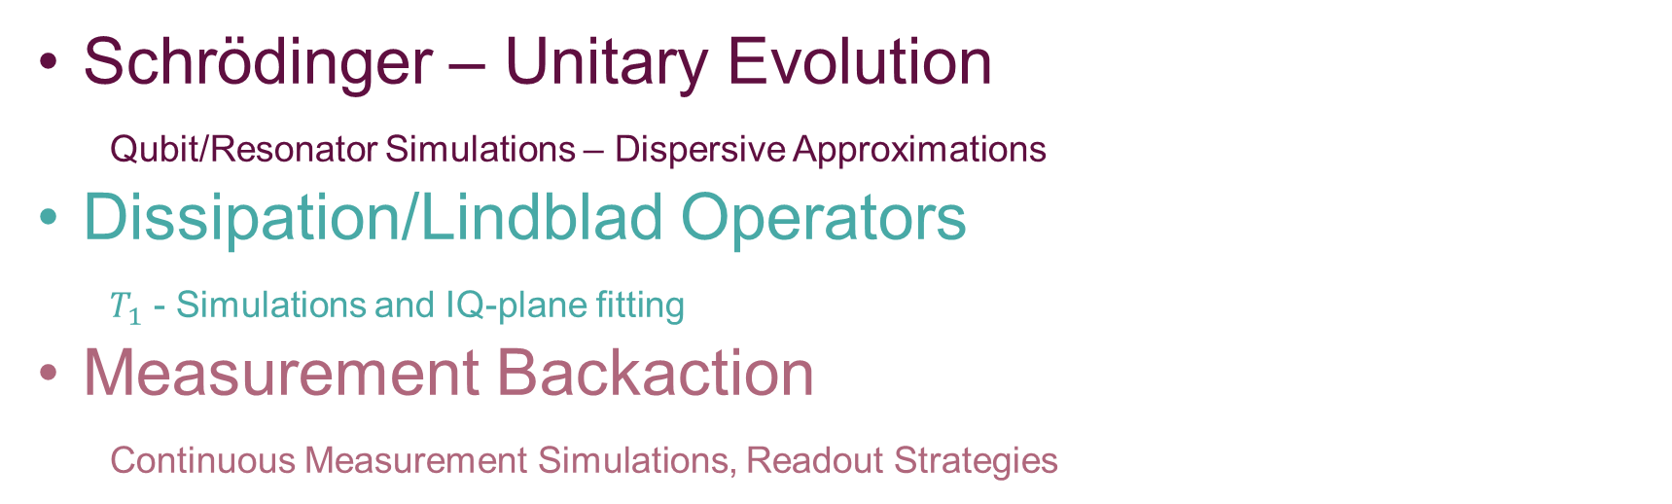
Towards Continuous Measurements
Johann Bock Severin
$$dρ=−i\left[H, ρ\right]dt+Σ_{n}𝒟\left[c_{n}\right]ρdt+Σ_{n}ℋ\left[c_{n}\right]ρdW$$
Schrödinger – Unitary Evolution
Qubit/Resonator Simulations – Dispersive Approximations
Dissipation/Lindblad Operators
$T_{1}$ - Simulations and IQ-plane fitting
Measurement Backaction
Continuous Measurement Simulations, Readout Strategies

Slide 3
Qubit – Resonator Interactions
$$dρ=−i\left[H, ρ\right]dt+Σ_{n}𝒟\left[c_{n}\right]ρdt+Σ_{n}ℋ\left[c_{n}\right]ρdW$$
$$H=Σ_{k}ω_{k}|k⟩⟨k|+ω_{r}a^{†}a+H_{drive}+H_{int}$$

Slide 4
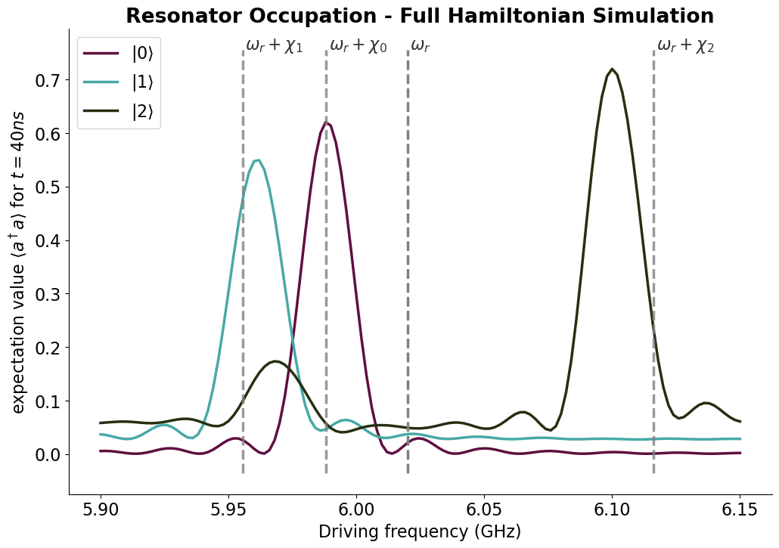
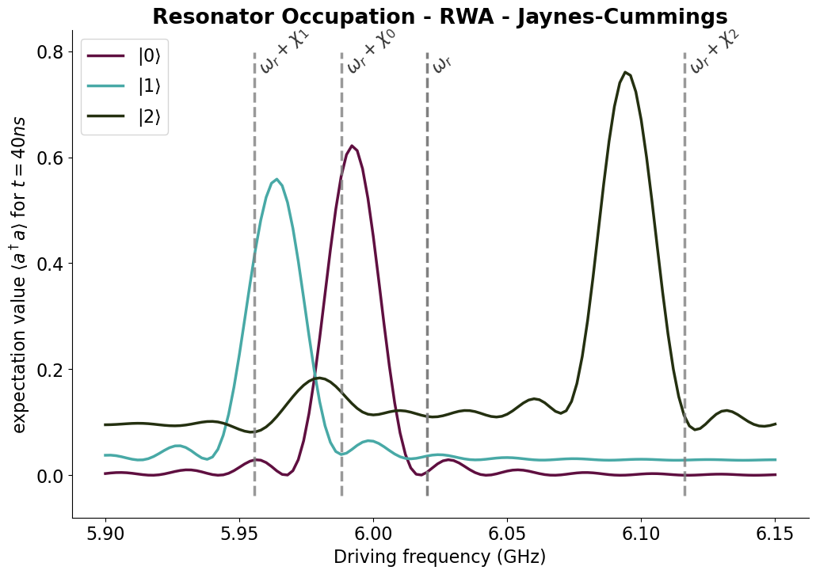
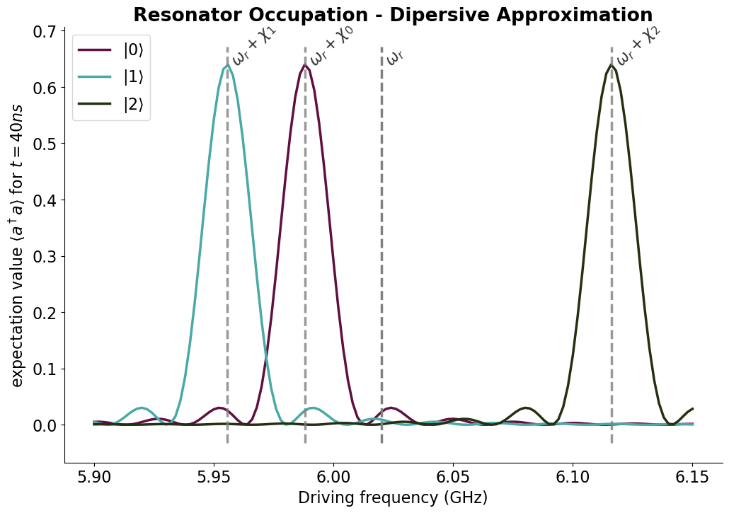
Qubit – Resonator Interactions
Different Interaction Approximations
$$dρ=−i\left[H, ρ\right]dt+Σ_{n}𝒟\left[c_{n}\right]ρdt+Σ_{n}ℋ\left[c_{n}\right]ρdW$$
$$H=Σ_{k}ω_{k}|k⟩⟨k|+ω_{r}a^{†}a+H_{drive}+H_{int}$$
$$H_{int}=Σ_{ij}g_{ij}\left|i\right\rangle \left\langle j\right|(a+a^{†})$$
$$H_{int}=g(σ_{−}a^{†}+σ_{+}a)$$
$$H_{0}+H_{int}=Σ_{k}χ_{k}\left|k\right\rangle \left\langle k\right| a^{†}a$$

Slide 5

Lindblad Master Equation
Dissipative Evolution
$$dρ=−i\left[H, ρ\right]dt+Σ_{n}𝒟\left[c_{n}\right]ρdt+Σ_{n}ℋ\left[c_{n}\right]ρdW$$
$$𝒟\left[c\right]ρ=cρc^{†}−\frac{1}{2}(c^{†}cρ+ρc^{†}c)$$

Slide 6

Lindblad Master Equation
Dissipative Evolution
$$dρ=−i\left[H, ρ\right]dt+Σ_{n}𝒟\left[c_{n}\right]ρdt+Σ_{n}ℋ\left[c_{n}\right]ρdW$$
$$𝒟\left[c\right]ρ=cρc^{†}−\frac{1}{2}(c^{†}cρ+ρc^{†}c)$$
Collapse Operators.
For $c=σ_{−}→ρ=|1⟩⟨1|→|0⟩⟨0|$

Slide 7

Lindblad Master Equation
Dissipative Evolution
$$dρ=−i\left[H, ρ\right]dt+Σ_{n}𝒟\left[c_{n}\right]ρdt+Σ_{n}ℋ\left[c_{n}\right]ρdW$$
$$𝒟\left[c\right]ρ=cρc^{†}−\frac{1}{2}(c^{†}cρ+ρc^{†}c)$$
Normalization terms
Collapse Operators.
For $c=σ_{−}→ρ=|1⟩⟨1|→|0⟩⟨0|$

Slide 8
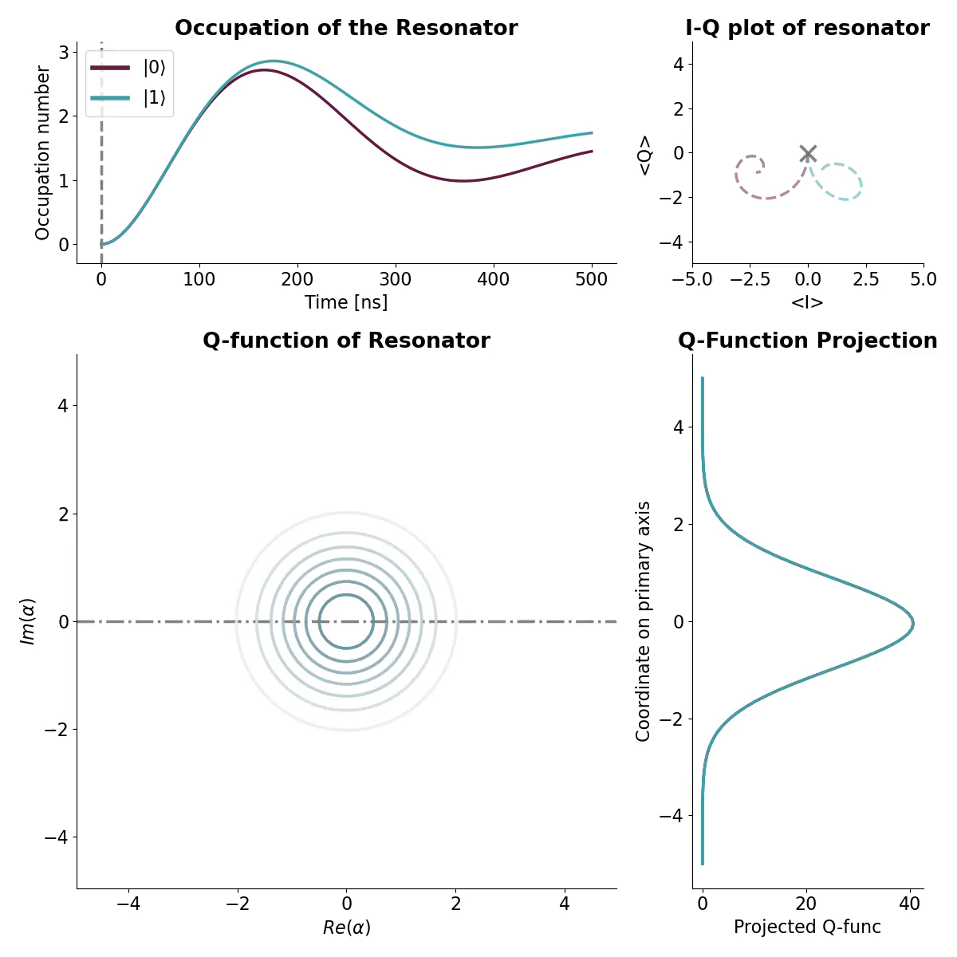

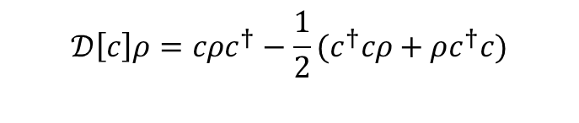
Lindblad Master Equation
Dissipative Evolution
$$dρ=−i\left[H, ρ\right]dt+Σ_{n}𝒟\left[c_{n}\right]ρdt+Σ_{n}ℋ\left[c_{n}\right]ρdW$$
$$𝒟\left[c\right]ρ=cρc^{†}−\frac{1}{2}(c^{†}cρ+ρc^{†}c)$$
$$c_{1}={\sqrt{Γ_{1}}σ}_{−}, c_{2}=\sqrt{κ}a$$
Possibilities:
Sampling of Data Points by Q-function
Use QFunc as PDF for fits
Separate SPAM-errors

Slide 9
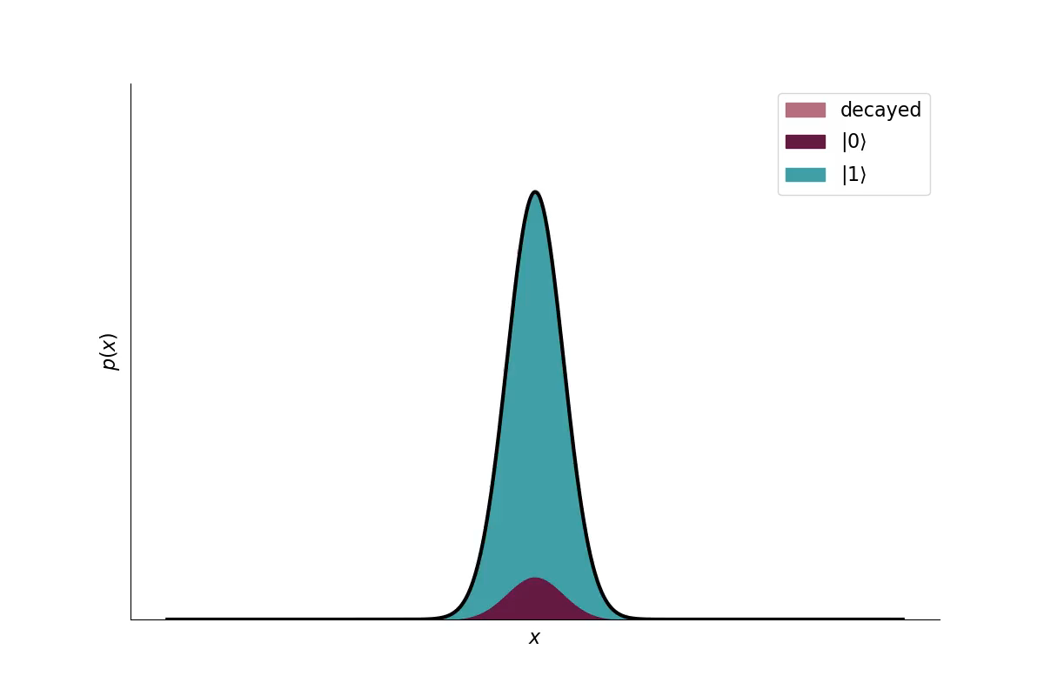
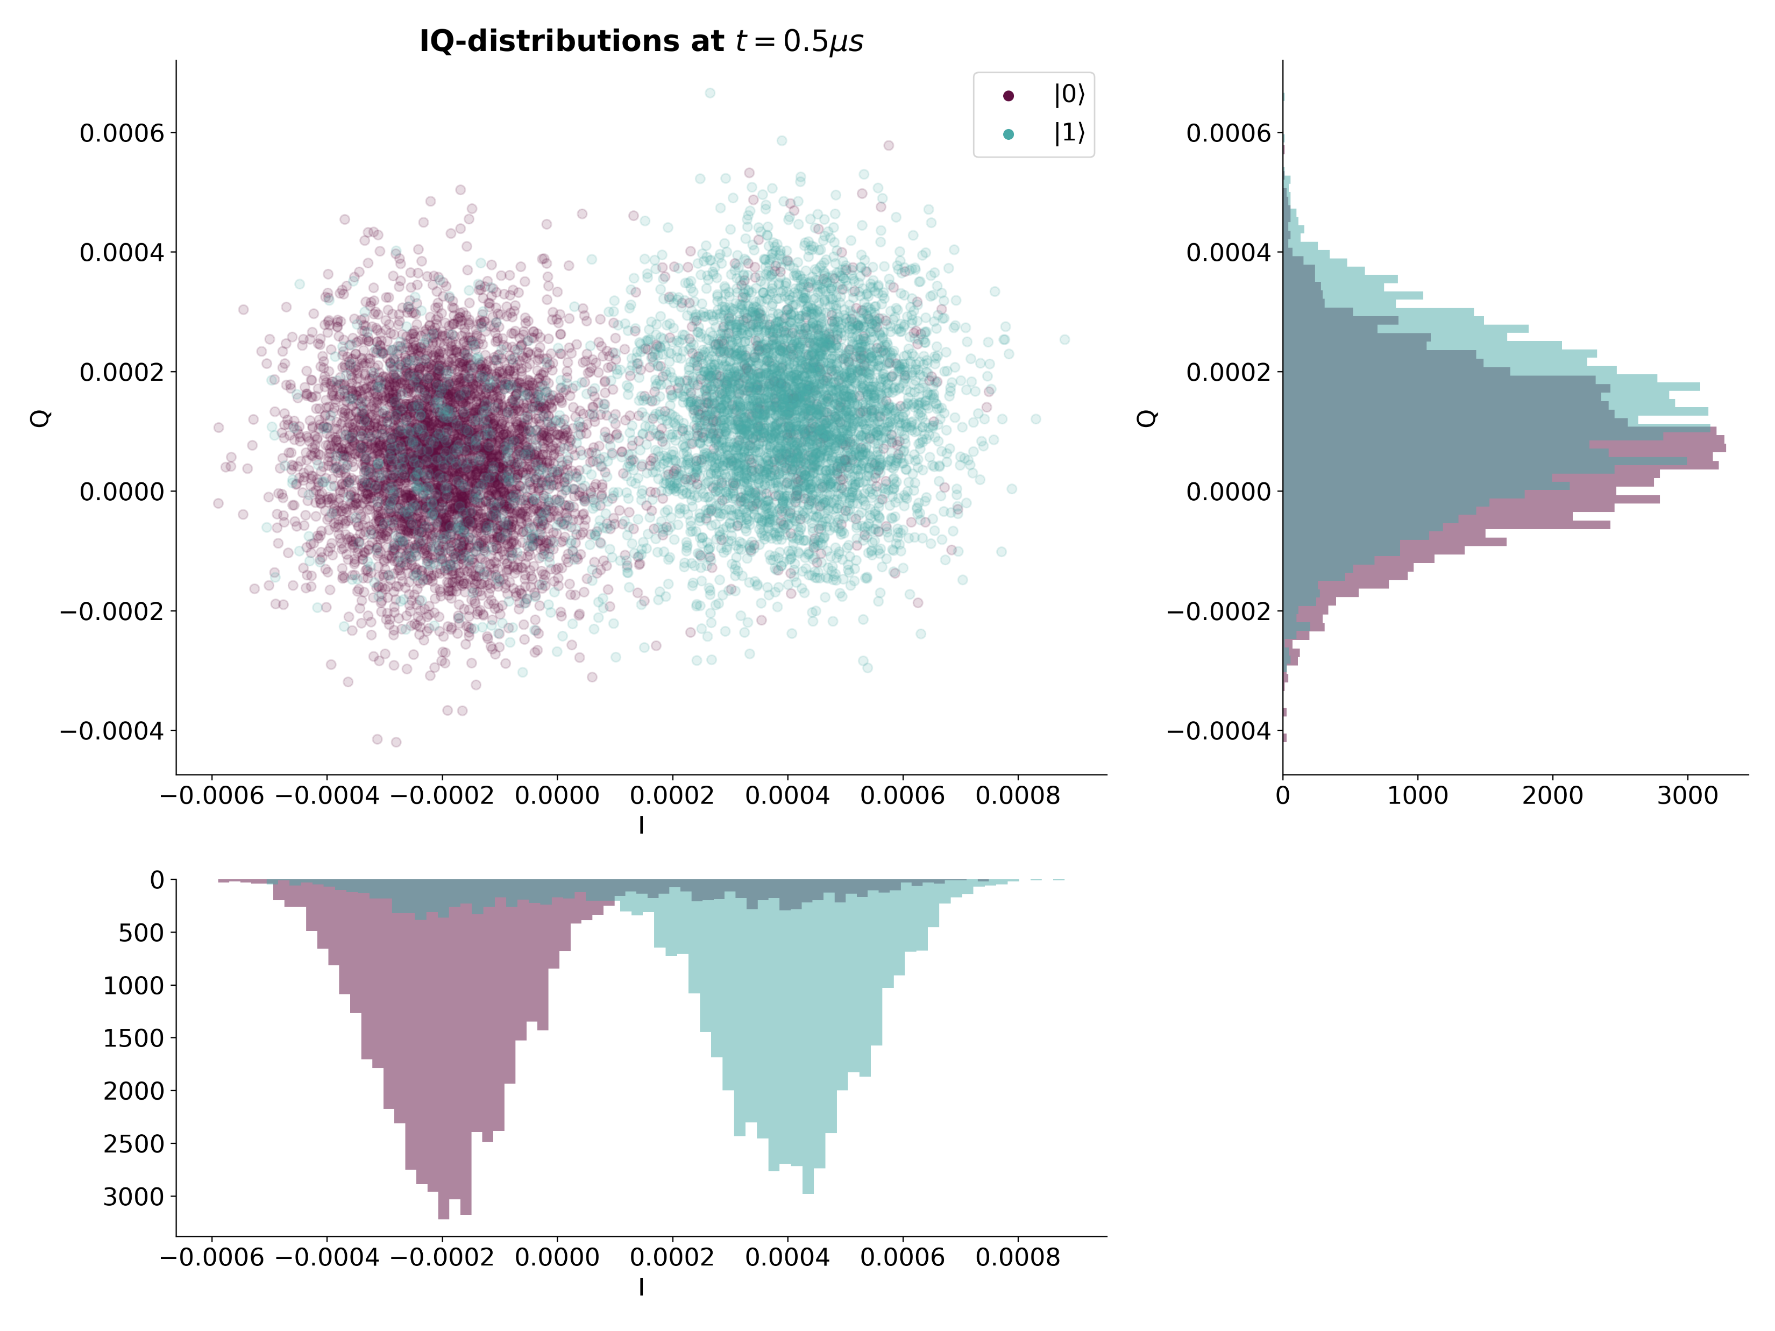
Calibration from IQ-Measurement
$$dρ=−i\left[H, ρ\right]dt+Σ_{n}𝒟\left[c_{n}\right]ρdt+Σ_{n}ℋ\left[c_{n}\right]ρdW$$

Slide 10
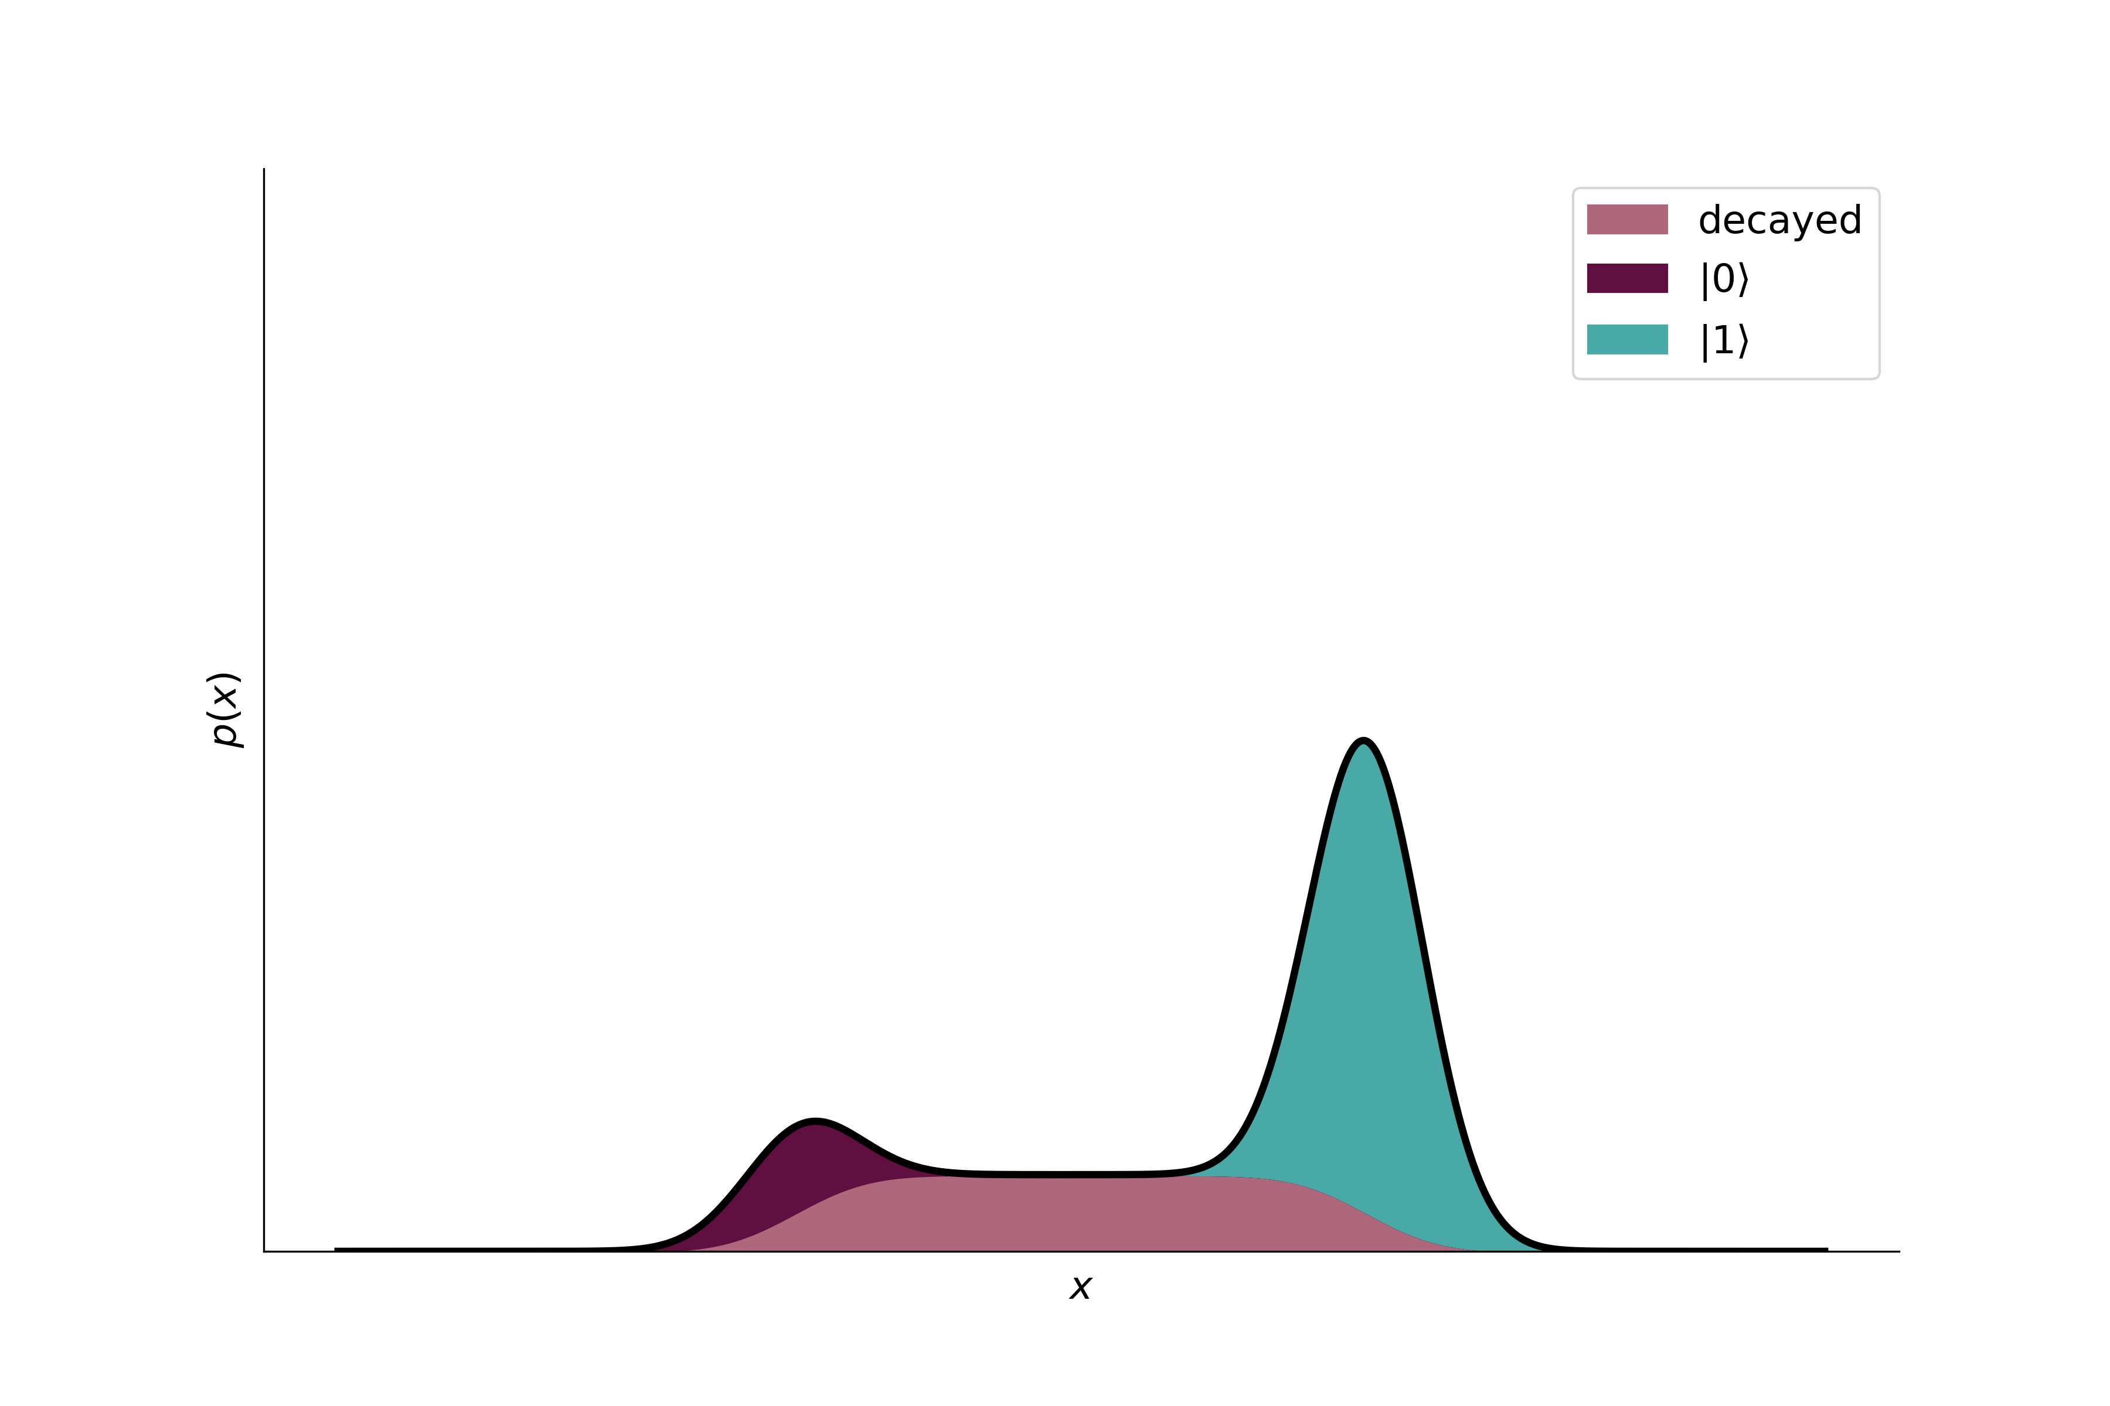
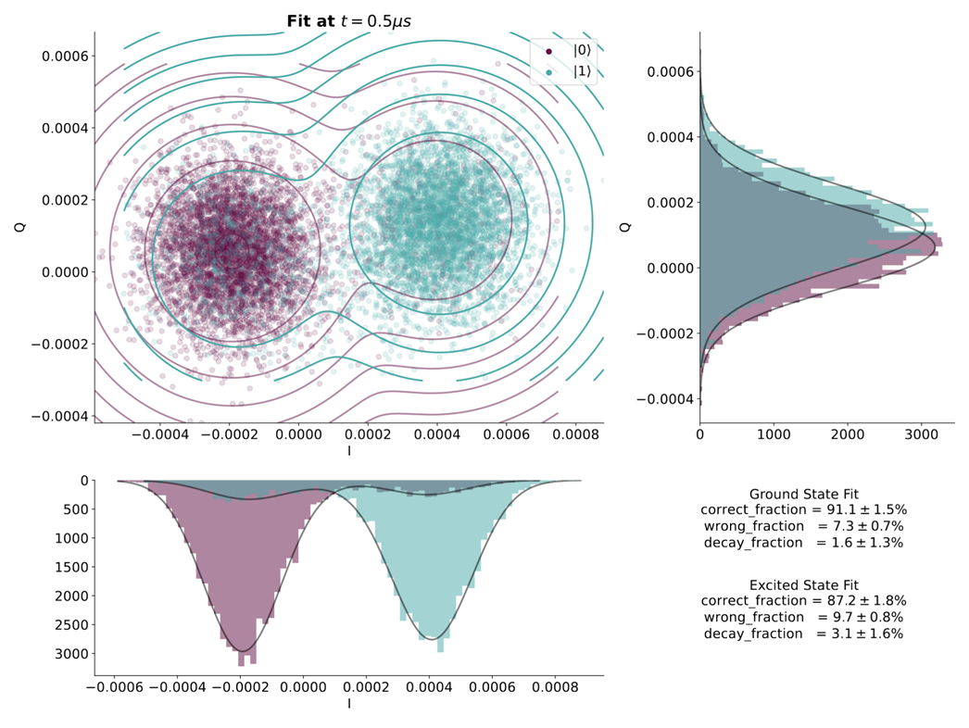
Calibration from IQ-Measurement
$$dρ=−i\left[H, ρ\right]dt+Σ_{n}𝒟\left[c_{n}\right]ρdt+Σ_{n}ℋ\left[c_{n}\right]ρdW$$

Slide 11
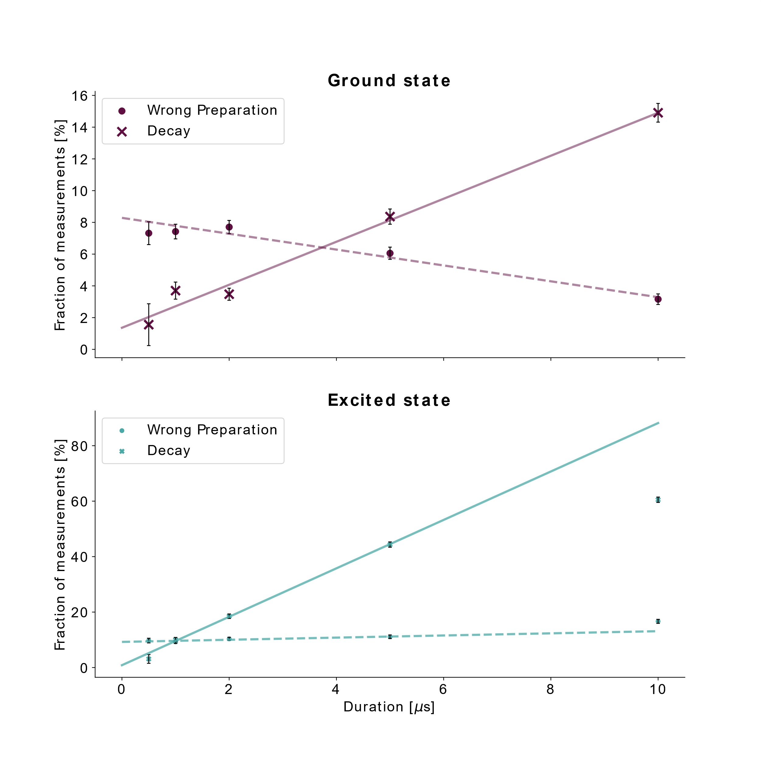
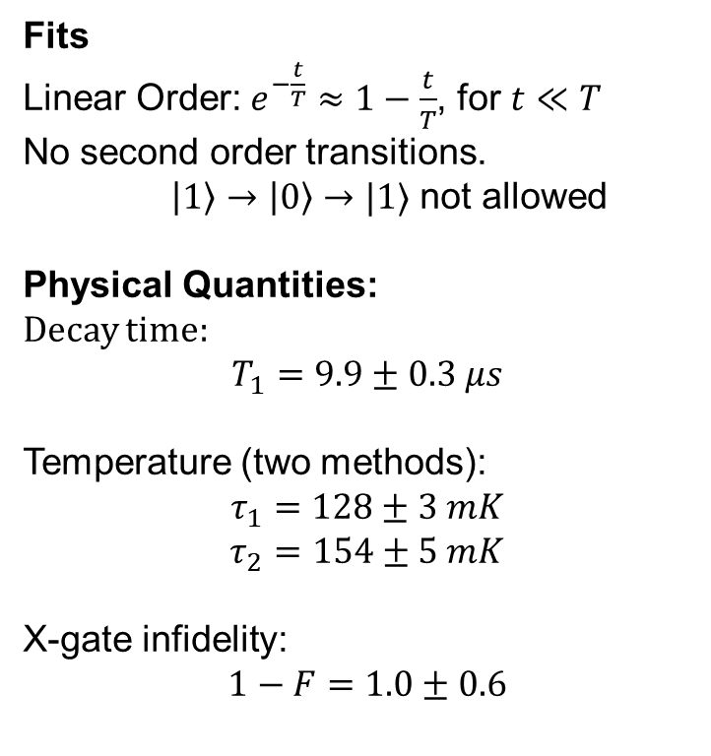
Calibration in IQ-Plane
Evolution
$$dρ=−i\left[H, ρ\right]dt+Σ_{n}𝒟\left[c_{n}\right]ρdt+Σ_{n}ℋ\left[c_{n}\right]ρdW$$
Fits
Linear Order: $e^{−\frac{t}{T}}≈1−\frac{t}{T}$, for $t≪T$
No second order transitions.
$\left|1\right\rangle →\left|0\right\rangle →|1⟩$ not allowed
Physical Quantities:
Decay time:
$$T_{1}=9.9±0.3 μs$$
Temperature (two methods):
$$τ_{1}=128±3 mK$$
$$τ_{2}=154±5 mK$$
X-gate infidelity:
$$1−F=1.0±0.6$$

Slide 12

Stochastic Master Equation
Measurement Back-Action
$$dρ=−i\left[H, ρ\right]dt+Σ_{n}𝒟\left[c_{n}\right]ρdt+Σ_{n}ℋ\left[c_{n}\right]ρdW$$
$$ℋ\left[c\right]ρ=\sqrt{η}\left(cρ+ρc^{†}−\left\langle c+c^{†}\right\rangle ρ\right)$$
$$dr=\frac{\left\langle c+c^{†}\right\rangle }{2}dt+\frac{1}{2\sqrt{η}}dW$$

Slide 13
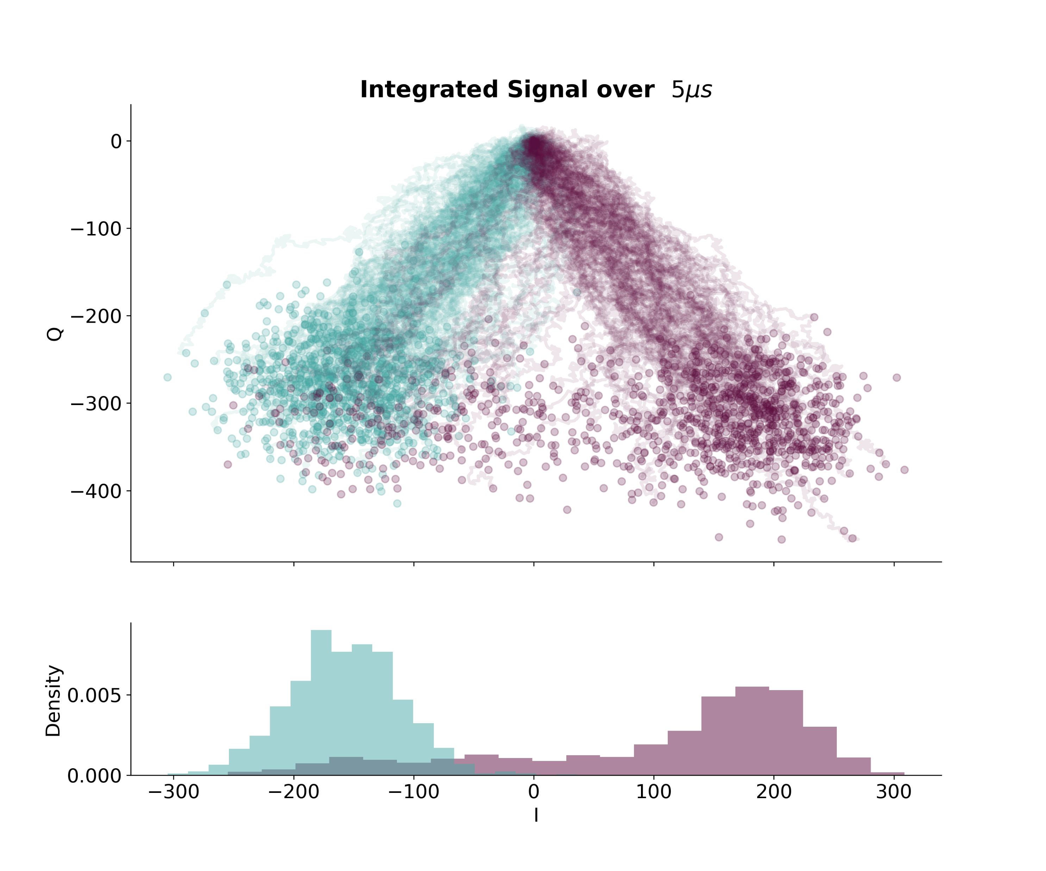
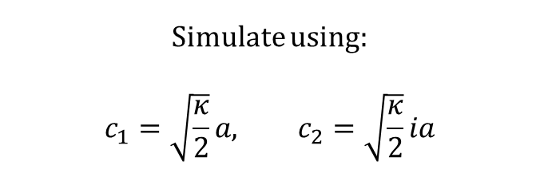
Stochastic Master Equation
Simulations
$$dρ=−i\left[H, ρ\right]dt+Σ_{n}𝒟\left[c_{n}\right]ρdt+Σ_{n}ℋ\left[c_{n}\right]ρdW$$
$$ℋ\left[c\right]ρ=\sqrt{η}\left(cρ+ρc^{†}−\left\langle c+c^{†}\right\rangle ρ\right)$$
$$dr=\frac{\left\langle c+c^{†}\right\rangle }{2}dt+\frac{1}{2\sqrt{η}}dW$$
Simulate using:
$$c_{1}=\sqrt{\frac{κ}{2}}a, c_{2}=\sqrt{\frac{κ}{2}}ia$$

Slide 14
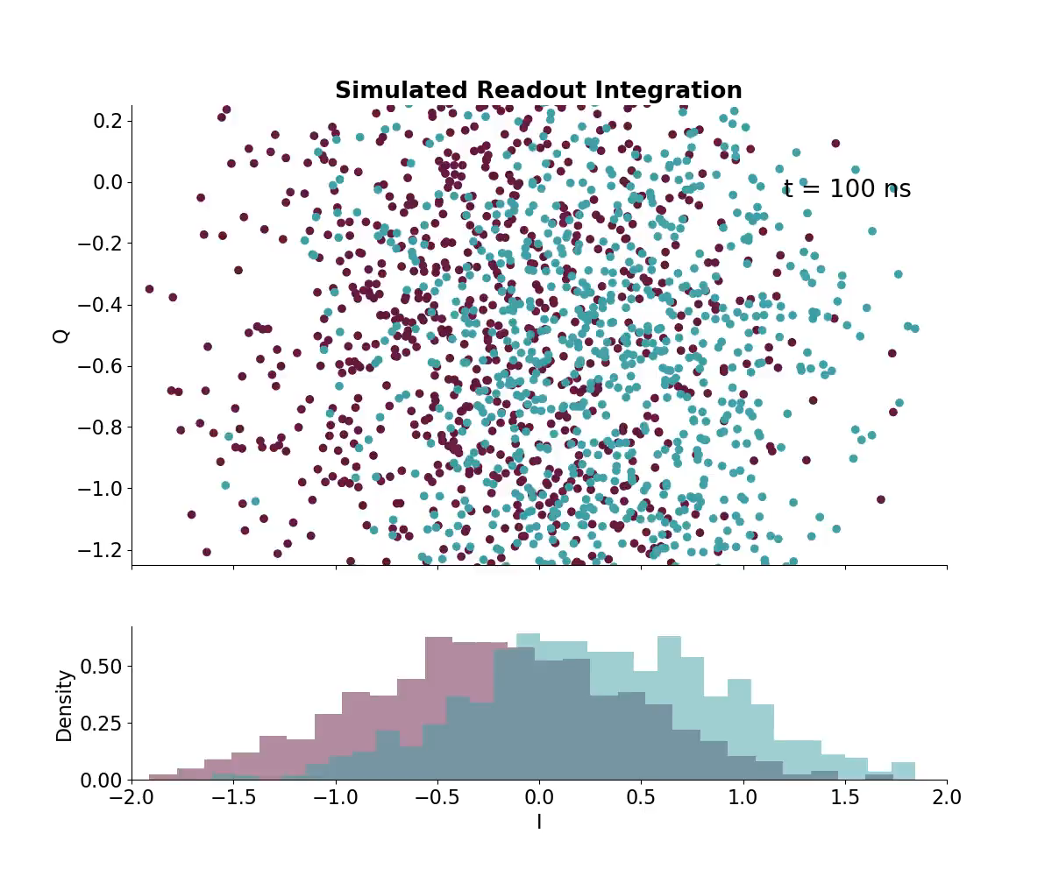
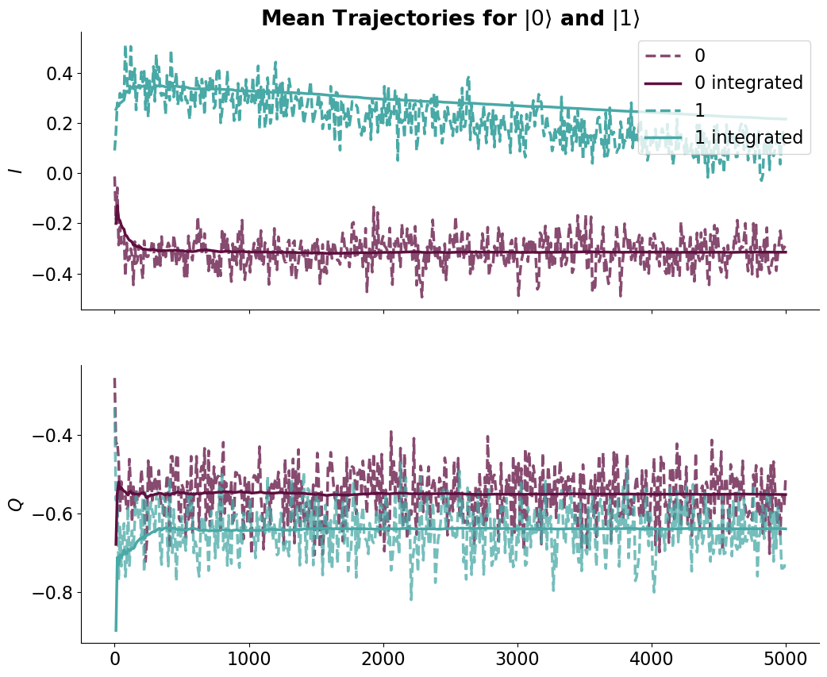
Integration Weights
Readout Simulation and Strategies
$$dρ=−i\left[H, ρ\right]dt+Σ_{n}𝒟\left[c_{n}\right]ρdt+Σ_{n}ℋ\left[c_{n}\right]ρdW$$

Slide 15
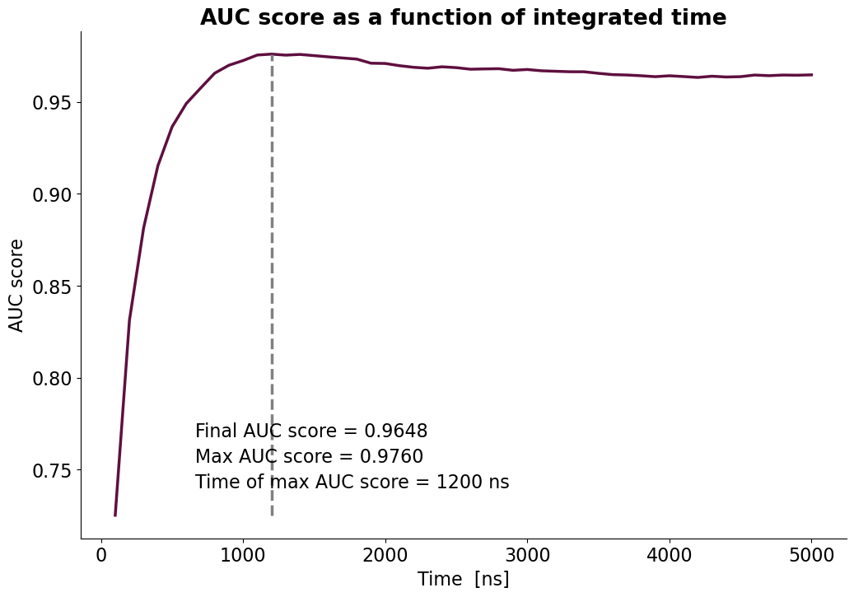
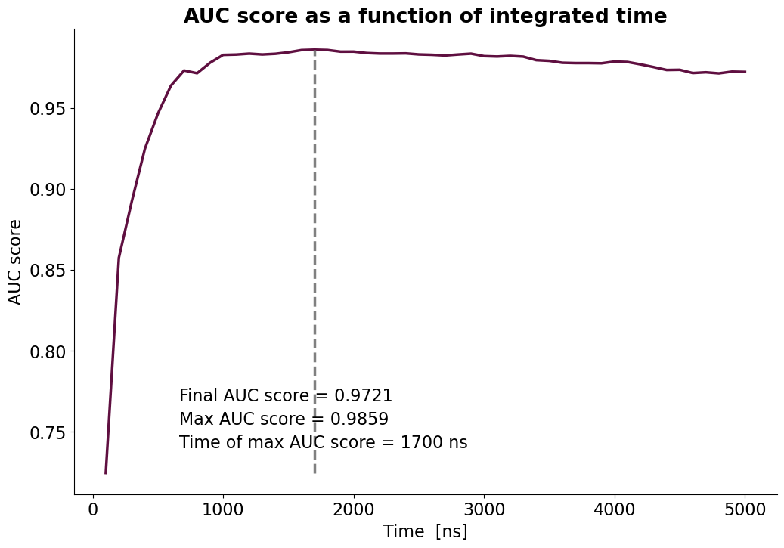
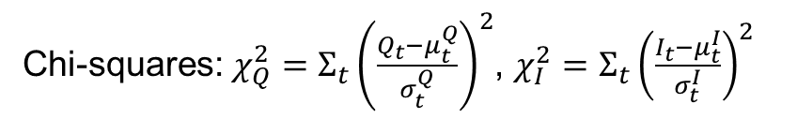
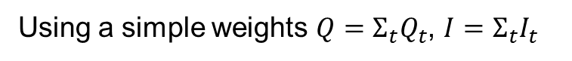
Integration Weights
Readout Simulation and Strategies
$$dρ=−i\left[H, ρ\right]dt+Σ_{n}𝒟\left[c_{n}\right]ρdt+Σ_{n}ℋ\left[c_{n}\right]ρdW$$
Chi-squares: $χ_{Q}^{2}=Σ_{t}{\left(\frac{Q_{t}−μ_{t}^{Q}}{σ_{t}^{Q}}\right)}^{2}$, $χ_{I}^{2}=Σ_{t}{\left(\frac{I_{t}−μ_{t}^{I}}{σ_{t}^{I}}\right)}^{2}$
Using a simple weights $Q=Σ_{t}Q_{t}$, $I=Σ_{t}I_{t}$
Burde lave visualiseringer af Metoder. Den første er bare afstand i det summet rum.
Kan dette visualiseres. Lav en std, der er bredde af noget visualiserbart.

